Slide 1
Bootstrap 3
Get Started
廖向德

Slide 2
What is Bootstrap?
Bootstrap is a free front-end framework for faster and easier web development
Bootstrap includes HTML and CSS based design templates for typography, forms, buttons, tables, navigation, modals, image carousels and many other, as well as optional JavaScript plugins https://bootswatch.com/cerulean/
Bootstrap also gives you the ability to easily create responsive designs
What is RWD(Responsive Web Design)?
Responsive web design is about creating web sites which automatically adjust themselves to look good on all devices, from small phones to large desktops.
Notes:
https://www.w3schools.com/bootstrap/bootstrap_get_started.asp

Slide 3
Why Use Bootstrap?
Easy to use: Anybody with just basic knowledge of HTML and CSS can start using Bootstrap
Responsive features: Bootstrap's responsive CSS adjusts to phones, tablets, and desktops
Mobile-first approach: In Bootstrap 3, mobile-first styles are part of the core framework
Browser compatibility: Bootstrap is compatible with all modern browsers (Chrome, Firefox, Internet Explorer, Safari, and Opera)
Notes:
https://www.w3schools.com/bootstrap/bootstrap_get_started.asp

Slide 4
Demo

Slide 5
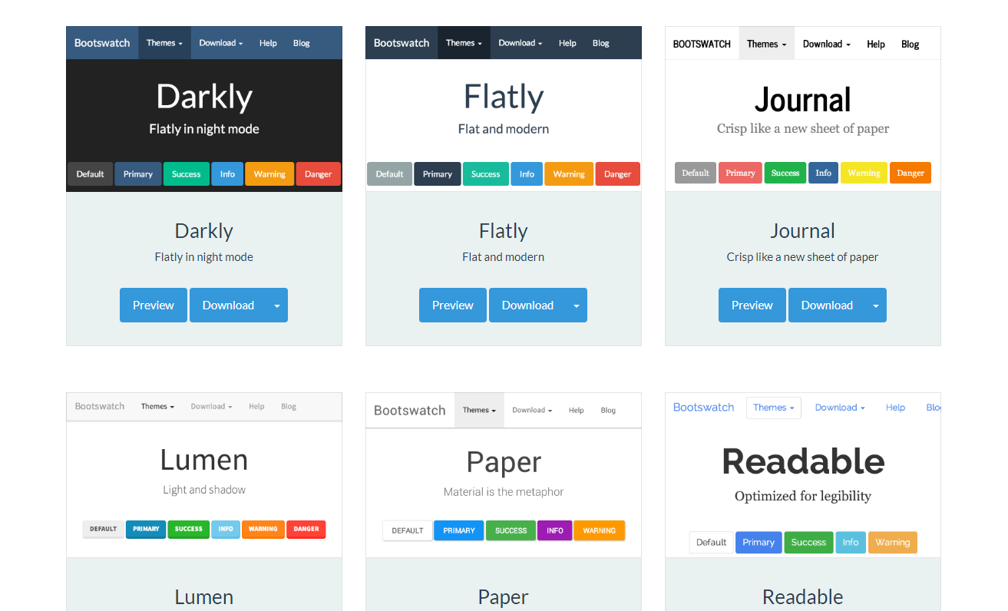
Choose themes you like
https://bootswatch.com/

Slide 6
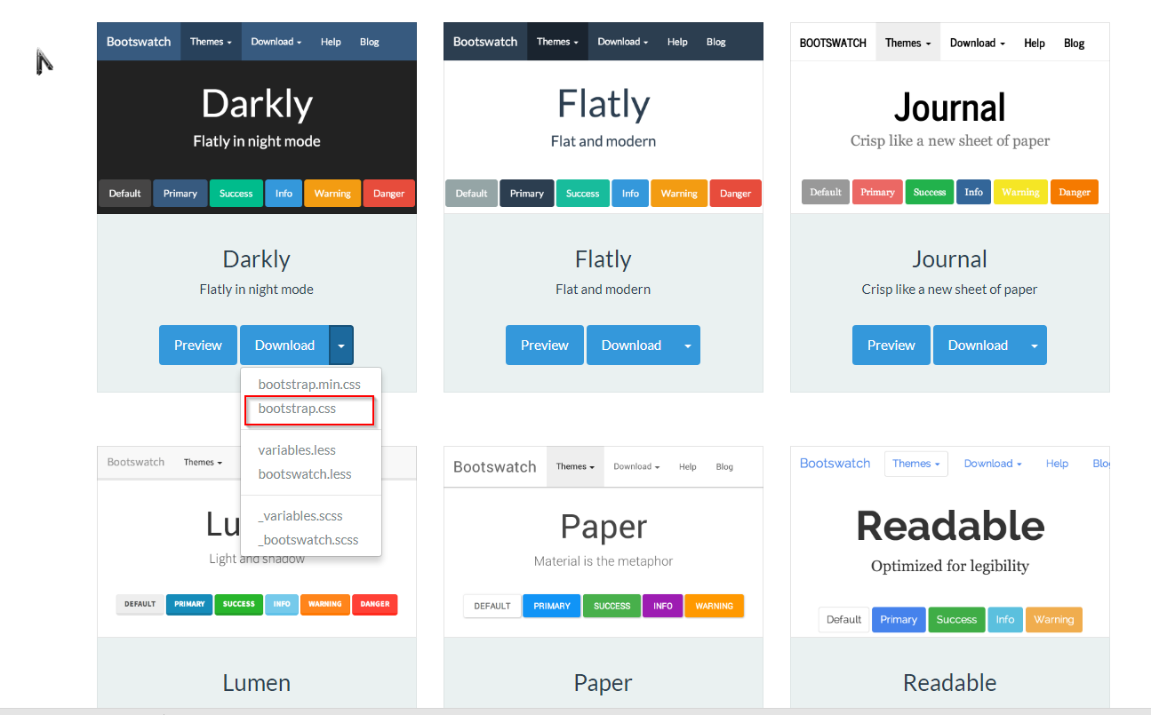
Choose themes you like

Slide 7
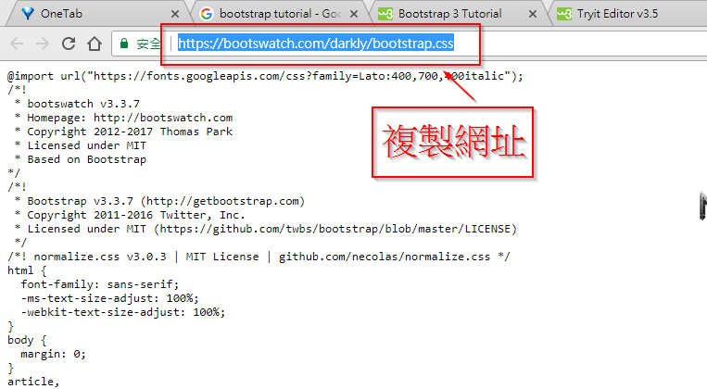
Copy theme’s URL or download

Slide 8
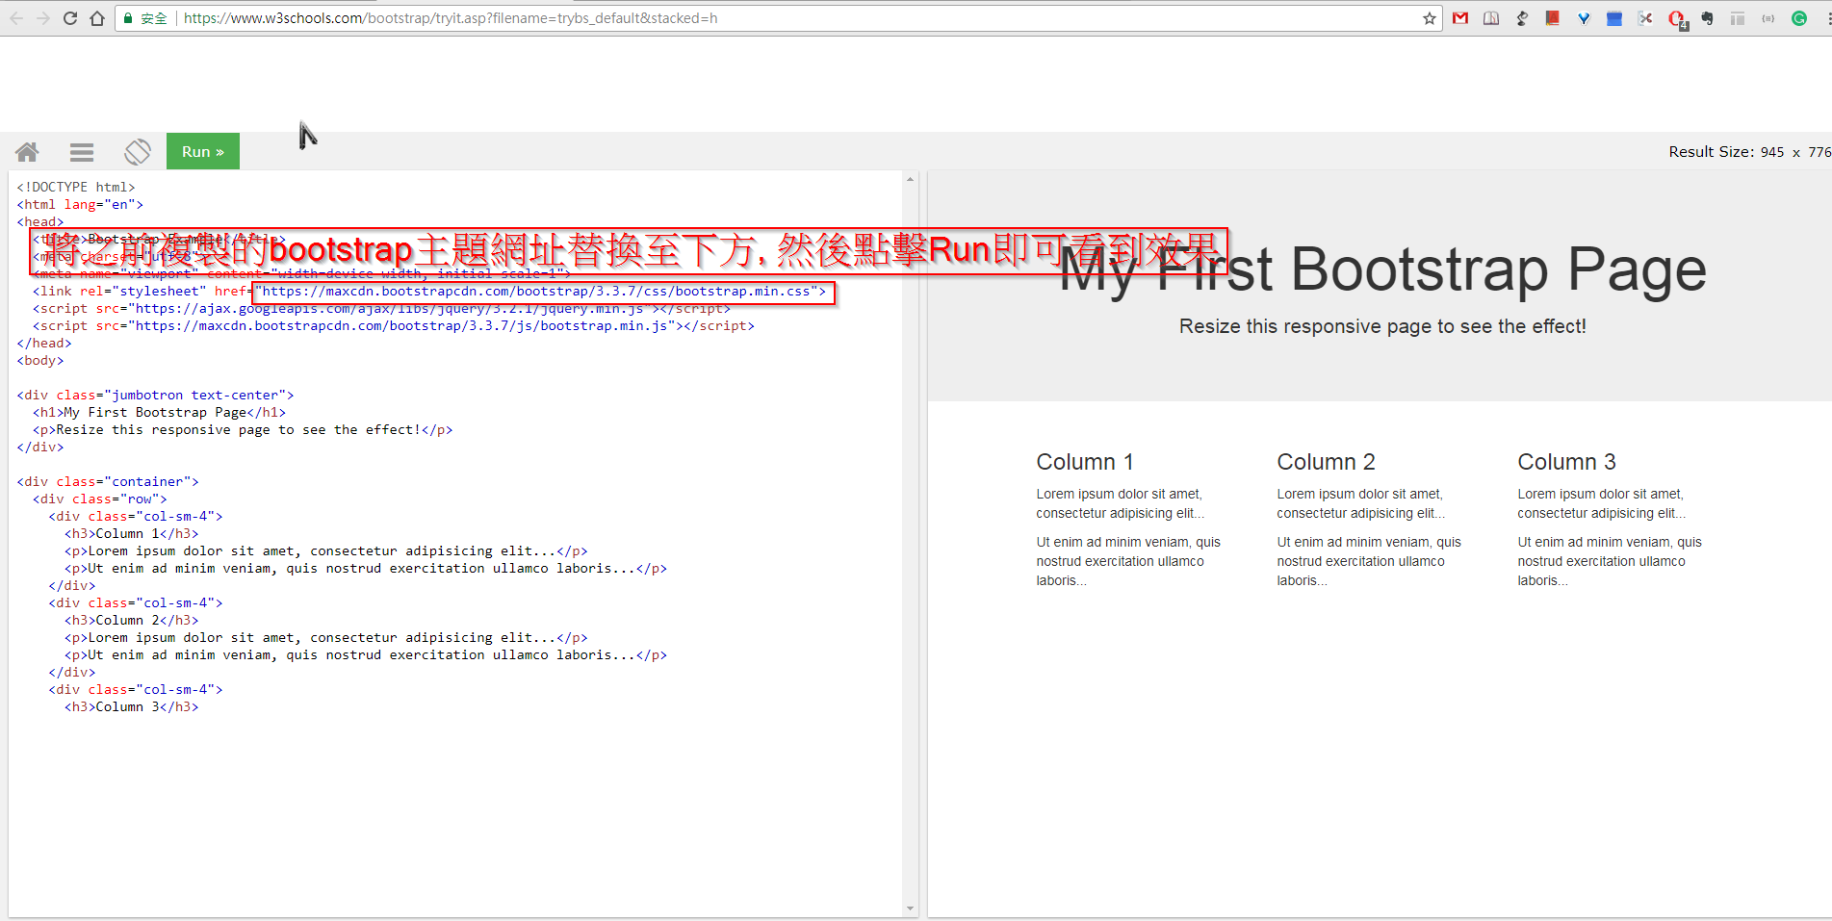
Apply different themes
Go to 「Tryit Editor (1 or 2) 」 apply different themes

Slide 9
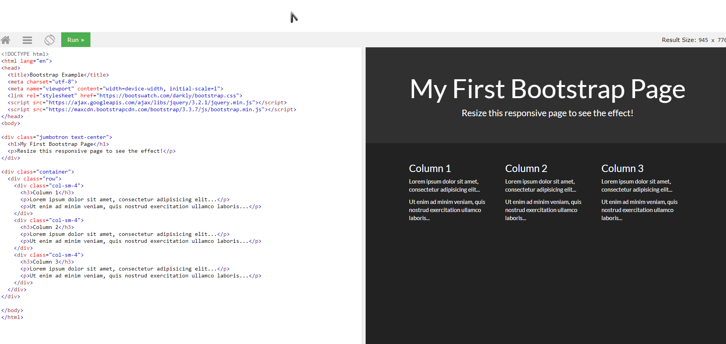
Apply Result

Slide 10


Slide 11
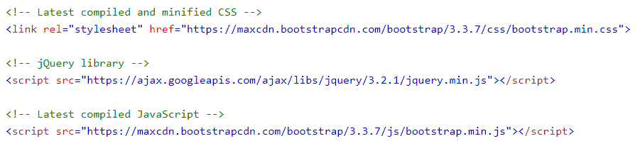
Bootstrap CDN
If you don't want to download and host Bootstrap yourself, you can include it from a CDN (Content Delivery Network).

Slide 12
Bootstrap CDN
One advantage of using the Bootstrap CDN:
Many users already have downloaded Bootstrap from MaxCDN when visiting another site. As a result, it will be loaded from cache when they visit your site, which leads to faster loading time. Also, most CDN's will make sure that once a user requests a file from it, it will be served from the server closest to them, which also leads to faster loading time.

Slide 13
Create First Web Page With Bootstrap

Slide 14
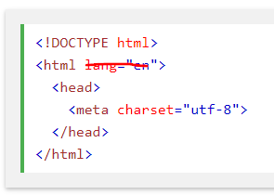
1. Add the HTML5 doctype

Slide 15

2. Bootstrap 3 is mobile-first
Bootstrap 3 is designed to be responsive to mobile devices. Mobile-first styles are part of the core framework.
To ensure proper rendering and touch zooming, add the following <meta> tag inside the <head> element:
The width=device-width part sets the width of the page to follow the screen-width of the device (which will vary depending on the device).
The initial-scale=1 part sets the initial zoom level when the page is first loaded by the browser.
Notes:
<meta name="viewport" content="width=device-width, initial-scale=1">

Slide 16
3. Containers
Bootstrap also requires a containing element to wrap site contents.
There are two container classes to choose from:
  The .container class provides a responsive fixed width container
  https://www.w3schools.com/bootstrap/tryit.asp?filename=trybs_gs_container&stacked=h
  The .container-fluid class provides a full width container, spanning the entire width of the viewport
  https://www.w3schools.com/bootstrap/tryit.asp?filename=trybs_gs_container-fluid&stacked=h
Note: Containers are not nestable (you cannot put a container inside another container).

